Slide 1

ECE 530 Cloud Computing
Ioannis Papapanagiotou
Relational

Slide 2
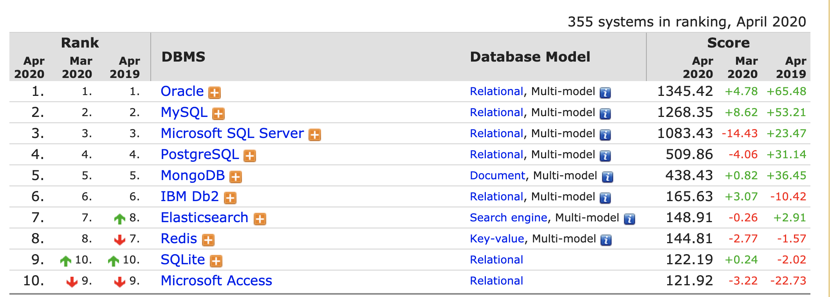
Database Rankings

Slide 3
Scaling RDBMS
Master-Slave
All writes are written to the master. All reads performed against the replicated slave databases
Critical reads may be incorrect as writes may not have been propagated down
Large data sets can pose problems as master needs to duplicate data to slaves
Multi-Master replication

Slide 4
Scaling RDBMS - Partitioning
Partition or sharding
Scales well for both reads and writes
Not transparent, application needs to be partition-aware (in contrast to DDB)
Can no longer have relationships/joins across partitions
Loss of referential integrity across shards

Slide 5
Challenge - Availability
A web-site is most likely to be unavailable when it is most needed → a huge volume of revenue loss
Goal of web services today is to be as available as long as the network is on.
When some nodes crash or some communication links fail, the service still performs as expected
One desirable fault tolerance capability is to survive a network partitioning into multiple parts.
Distributed DBMSs (covered in the course) provides no solutions yet …

Slide 6
Beyond traditional RDBMS
“… the whole point of seeking alternatives is that you need to solve a problem that relational databases are a bad fit for …”
- Eric Evans
Class of non-relational data storage systems
Usually do not require a fixed table schema nor do they use the concept of joins
Relax one or more of the ACID properties
Brewer’s CAP theorem

Slide 7
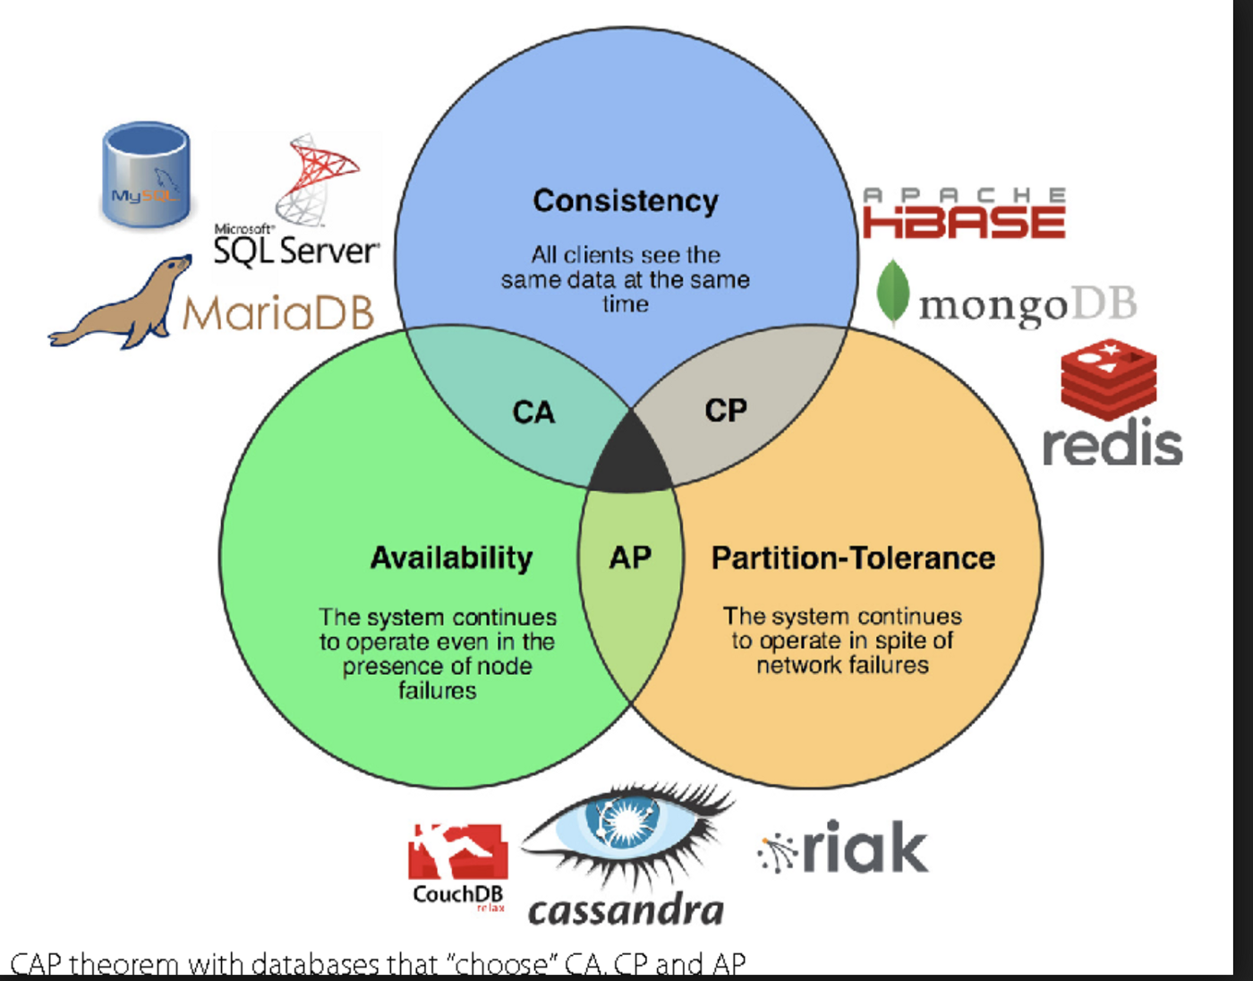
CAP Theorem and Relational Systems
SQL databases emphasize ACID (Atomicity, Consistency, Isolation, Durability) where NoSQL focuses on BASE (Basically Available, Soft-State, Eventual Consistency). These are both based on Brewer’s CAP thereoem (visualized below). A common definition for CAP is “In the face of network partitions, you can’t always have both perfect consistency and 100% availability. Plan accordingly.”

Slide 8
Relational Storage 1
This is the familiar database, such as Oracle, MS SQL Server, MySQL, Postgres. Made up of tables containing typed columns (schema) and rows (data)
Used when relationships between tables are necessary and complex. For example, an order (row in table of orders) contains a reference to a product (row in table of products) and a customer (row in a table of customers). The customer contains a reference to an address table and payment source table, etc.
Database system itself enforces data integrity, for example, you can’t delete a customer when an order refers to it.

Slide 9
Relational Storage 2
Have historically been the bottleneck of large systems
Scale up well on a single node, often a large fast one, but have more trouble scaling out (e.g. cloud), because of need for consistency
Having said that, most legacy data is in this type of storage, so you won’t lose them any time soon.

Slide 10
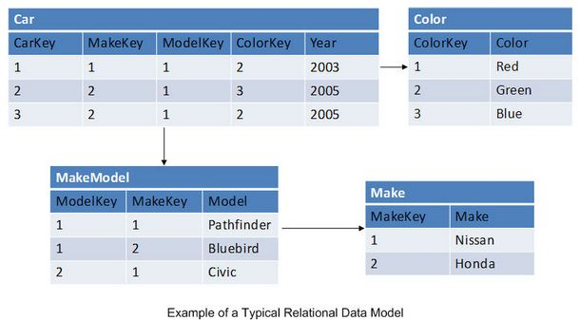
Common Relational Usage Case

Slide 11
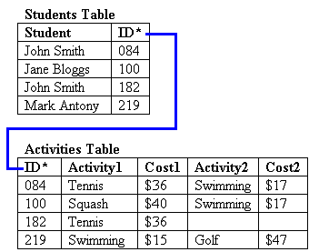
Background: Relational DB
In relational databases, a table is an organized set of data elements (values) using a model of vertical columns (which are identified by their name) and horizontal rows, the cell being the unit where a row and column intersect

Slide 12
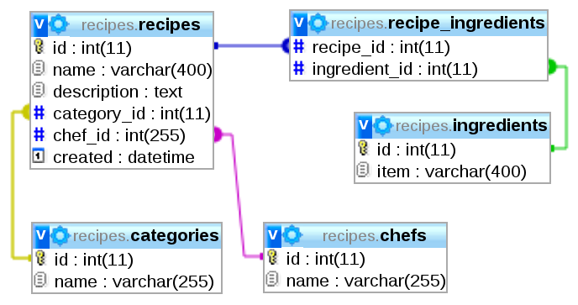
Background: Relational SQL Joins
A SQL join clause combines records from two or more tables in a database.
It creates a set that can be saved as a table or used as it is.
A JOIN is a means for combining fields from two tables by using values common to each.
Notes:
ANSI-standard SQL specifies five types of JOIN: INNER, LEFT OUTER, RIGHT OUTER, FULL OUTER and CROSS. As a special case, a table (base table, view, or joined table) can JOIN to itself in a self-join.

